Slide 1
Smart Web-Application for Grocery E-Commerce
Thesis Presentation
Supervisor:
Dr. Adamkó Attila Tamás
Associate Professor
Candidate:
Danish Sihag
Computer Science BSc.

Slide 2
The Task to be Solved
My task was to work on the development of an e-commerce web-application for grocery shopping.
The main features that were to be implemented were:
The 1st and one of the most important steps was that the website should be fully responsive.
There should be a database that stores the details of all users when they create a new account.
The main page of the website should be attractive, but at the same time, it should be simple and easy to use and not filled with complex visuals or navigations.
To make the website attractive, some animated elements should be present (here, Bootstrap carousel was used).
The categories for all products should have their own pages, for improvised user navigation.
Some non-interactable elements should be used after the product category section, to make it look more appealing.
Each individual item inside the product must contain an image of the item, an ‘add to cart’ button, along with its price.
One more important feature to add was the Search Bar and its functionality.
A go to cart button was to be implemented.
Inside the shopping cart page, all the individual items that were added must be displayed, along with image, price, a quantity-changing button and the total for each individual item based on its quantity. Also, the shopping cart page must show the total price, and have a continue button, to go to the actual checkout page.
The checkout page must contain a short form, and the details entered must be inserted in the database so that the admin can see what was bought and send the delivery. After submitting this form, should be redirected to the payment page.
The payment page must contain a final summary of all the products and a method to make the actual payment.

Slide 3
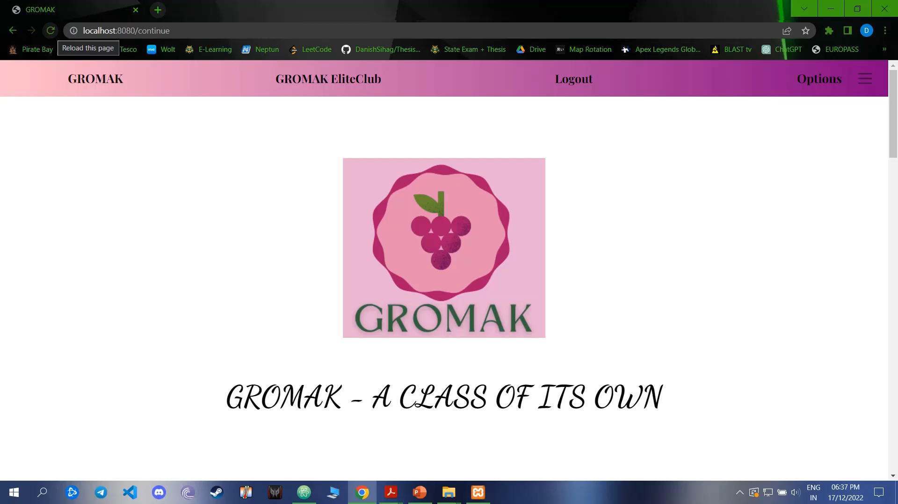
Technologies and Methods Used
The web application was made using HTML, CSS and JavaScript for the front-end section and NodeJS along with JavaScript for the back-end and server-side part.
Regarding the storage of items, MySQL database was used via XAMPP software, which was also used for generating Apache web server for the corresponding web page output.
The products in database were inserted and handled using the MySQL administration tool, phpMyAdmin.
To make my web application fully responsive, the popular CSS framework, Bootstrap(v5.2.2) was also used. This was done so that the website does not break and avoids visual clutter when the window size is shrunk.
During the development of the project, clear and concise commits were made in GitHub for each new functionality added. The link is given : https://github.com/DanishSihag/Thesis_Web_Application
For reference of all individual items, the ‘myscript.js’ file can be checked, which has the dummy data for all products. It should be noted that the actual products were added in the database and not inside the JavaScript file.
During the development of the project, normal HTML files were used to monitor the progress on my local machine for rendering the web-pages.
After all the html files were completed, ’ejs’(Embedded JavaScript Templating) extension files were made, containing the same content of the HTML files, so that they could run on the localhost server with the specified port.
For using the localhost server, ExpressJS was used to create a session.
The link for demo of the presentation is given:
https://drive.google.com/file/d/1tnQfyzzLkduIpanJMqs1-_PkbCHmVwo1/view?usp=share_link
(In case the link does not work, expand and use this -> )

Slide 4
Description of Work
The task is the development of an e-commerce web-application for grocery shopping. The basic idea is to create a user-friendly website which is fully responsive with a simple but attractive UI design for the customer to use.
The database related to the website is populated with various items that are related to grocery shopping. These items are then displayed on the actual website, in their respective categories. MySQL was used for this purpose.
The user can register themselves in the database on the Login/Create Account page and their details are recorded in the database. For this too, MySQL was used as the database.
After registering in the database, they can go to the main page of website using ‘continue’ button from login page.
The main page of the website contains a top navigation bar which also contains option for logout, made from Bootstrap.
It also contains an offcanvas-right-navbar which has other user-related options, like the FAQs button and previous orders.
There is a carousel slider present on the main page, which has six slides, and the user can switch to any slide using the carousel-slider buttons, or by clicking on the indicators. This was also made with help of Bootstrap carousel.
Below the carousel slider is the products categories section. There are a total of 14 categories, and overall, there are 310 different types of grocery-related products that the user can choose from.
Below the categories section is the premium club membership benefits section.
The last section below the premium membership, is the benefits of choosing GROMAK section.
When a user clicks on any product category, they are redirected to the page containing all the individual products from that category.
Each product contains an image, its name, its price and the ‘Add to Cart’ button. All of this is inside a Bootstrap ‘card’.
A search bar is provided at the top navbar, if the user wants to search for a specific product in that particular category.

Slide 5
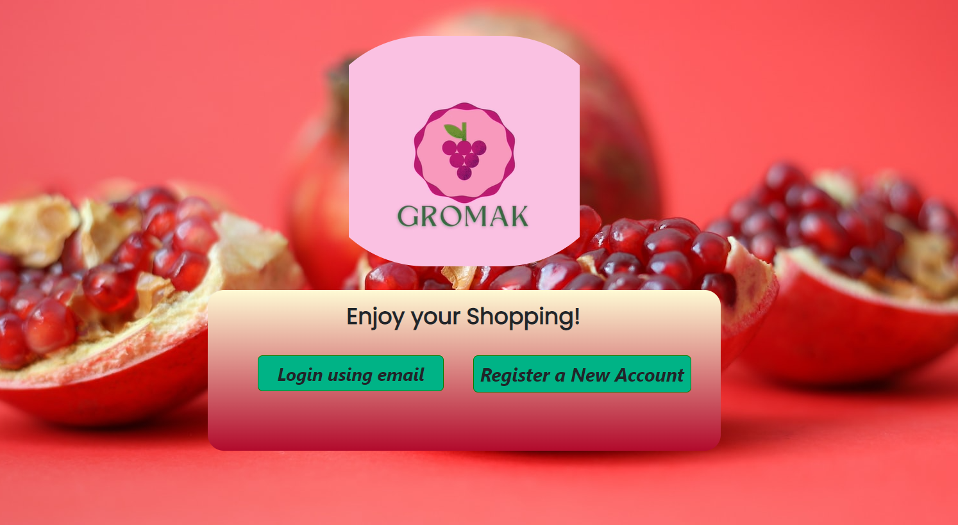
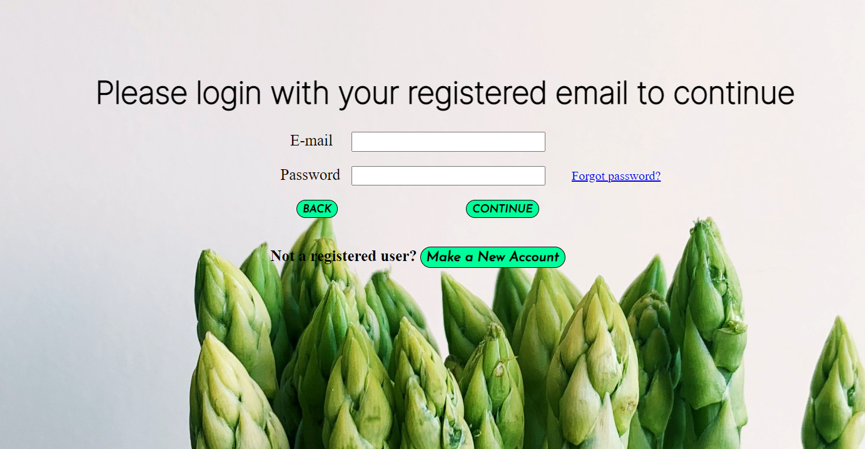
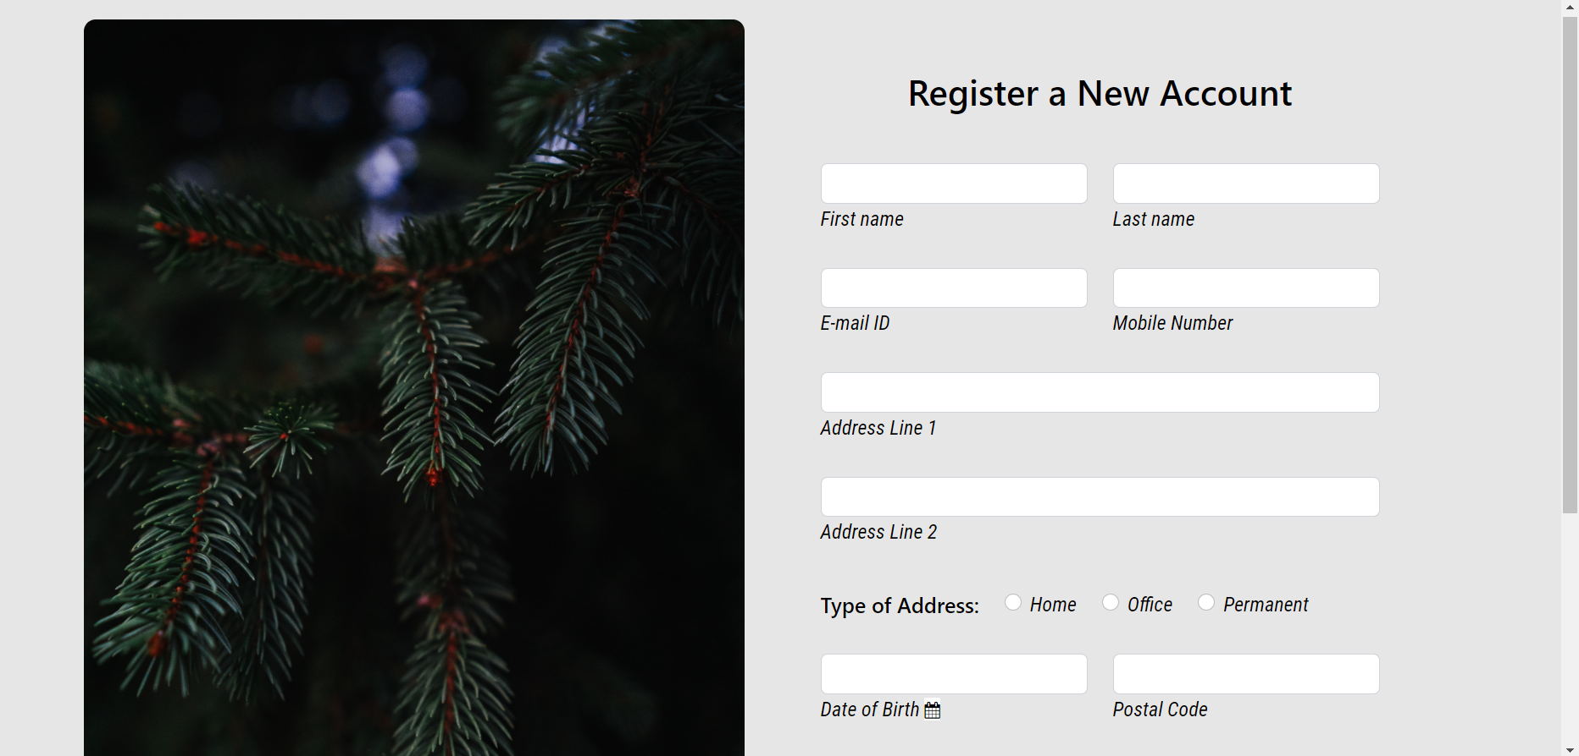
A ‘Go to Cart’ button has also been provided on each product page, if the user wants to check their cart products.
When a user clicks on the ‘Add To Cart’ button, that product is added to the shopping cart and the user is redirected to the shopping cart. If the user wants to add any other product, they can go back and add more products to the cart.
The shopping cart page contains all the products that have been added. For each item, it contains a delete button, which removes that item from the cart. There are buttons for increasing/decreasing the quantity of the desired item. The total for each individual product is shown, and at the bottom of all the items, the total cart price is also given.
There is a ‘Checkout’ button present at the bottom of the page. When the user clicks on it, they are redirected to a registration form in which they fill their details to continue to the payment page. All these details are stored in the database also, so that the admin can verify who has placed the order.
After they have filled this form, the user can click on submit button and they redirected to the payment page. On the payment page, a final summary of all the products and the total cart price is shown.
There is an option to pay using PayPal, or it can be done via a debit/credit card. Once the user has completed payment, all the items are removed from the cart. But this is only done if the payment is successful.
Screenshots for the registry pages have been provided. For the main website, a demo video will be shown.

Slide 6
Conclusion and Further Development Opportunities
We have discussed the important conceptions, technologies and the notions that are paramount in building a web-based application. The defining features of the web-application such as the login page, the ‘add to cart’ button, the search functionality and the implementation of a payment gateway were also discussed.
There are a few implementations that could be performed on this project, which would make the web-application better:
A ‘Favourites’ tab could be included in the project, which would store the favourite items of the user.
We could implement a method that guides the user throughout the website, if they are using the web-application for the first time.
Some more payment methods could be included which would provide more flexibility regarding the payment system.
On an enterprise-level scale, we could implement a ‘track your order’ method, which will show the user where their order is on the map and by what time is it expected to arrive.

Slide 7
Acknowledgements and Bibliography
I would like to thank my Supervisor, who helped me throughout this project and provided important inputs wherever I needed them. I would also like to thank my friends who helped me understand web-related technologies in a deeper manner so that I could implement them in the project. Lastly, I would like to thank my family, who supported me whenever I was in need of it.
Bibliography:
For the web-related technologies of HTML/CSS/JavaScript/NodeJS, MDN Web Docs were used.
For explaining phpMyAdmin, MySQL and XAMPP Panel, their official websites were used, respectively.
For monitoring the development of project and for the supervisor’s reference, commits were made on GitHub, the personal GitHub for the project has also been included in the thesis bibliography.
While using fluid attributes related to web-development, documentation from Bootstrap was used, for each different type of attribute that was included in the web-application.
Citations from Wikipedia were used to explain introduction to web-application and also to explain POST method. These were done very carefully, to explain only what was absolutely needed in the project, as Wikipedia is not highly reliable.
For certain fonts, documentation from Google Fonts and Font Awesome was used.
To integrate the PayPal Gateway with the project, documentation from PayPal Developers was also utilized.

Slide 8
Thank You

